Slide 1
Centuries of
Miniature Books
Presentation provided courtesy of the
Miniature Book Society, Inc.
Use is limited to education purposes only. No reproduction permitted.

Slide 2
THE HISTORY OF MINIATURE BOOKS
A miniature book is generally defined as being a tome approximately 3 inches tall by 3 inches wide or smaller. However books up to 4 inches are considered miniature, especially if they are older and were meant to be a miniature.
Books in a miniature format possess a special appeal to many collectors. There is an intimacy and charm about them. Their small dimensions demand a gentle touch and careful handling. But in spite of their small size, minis satisfy very practical needs.
Collectors of tiny tomes have included Napoleon, Franklin Delano Roosevelt, Oliver Wendell Holmes, Queen Elizabeth and Stanley Marcus of Neiman Marcus. Henry Stanley, of Stanley and Livingston fame, carried a miniature copy of Burn’s poems into darkest Africa.

Slide 3
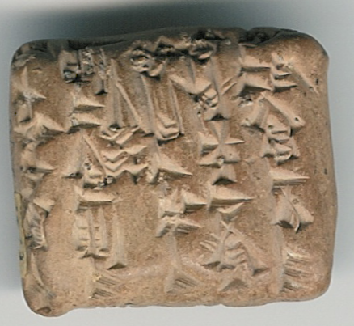
CUNIEFORM TABLETS
Almost As Old As the Written Word
Is Its Presentation in Miniature Form
Ancient Babylonian clay tablets, date from around 4000 to 5000 BC, and were of such small size and such significance that they are considered the very first truly miniature documents that have survived. These tablets were the first documents to record codes of law, legal documents, works of science, history, literature and religion, contracts, partnership agreements, even promissory notes. This tablet dates from about 2300 BC and deals with the issue of barley and bran for sheep, it measures 1” wide and 7/8” high.
Notes:
Ancient Babylonian clay tablets, date from around 4000 to 5000 BC, and were of such small size and such significance that they are considered the very first truly miniature documents that have survived. These tablets were the first documents to record codes of law, legal documents, works of science, history, literature and religion, contracts, partnership agreements, even promissory notes. This tablet dates from about 2300 BC and deals with the issue of barley and bran for sheep, it measures 1” wide and 7/8” high.

Slide 4
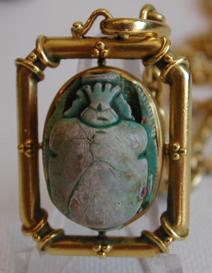
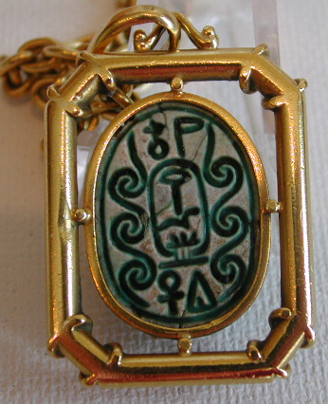
EGYPTIAN SCARABS
Like the Babylonian tablets, the ancient Egyptian scarabs are precursors to miniature books. Scarab means beetle in Latin, and the beetle was sacred to Egyptians – they believed it was a symbol of immortality. Hard stones were fashioned into beetle shapes and the flat back was engraved. Scarabs were placed in tombs and often engraved with sections from the Book of the Dead.
Other scarabs were used as seals, inscribed with details of historical events, marriages, and births for example. These inscriptions were done in hieroglyphics.
This “Second Intermediate Period” scarab is made of green glazed steatite, and is inscribed with the royal cartouche of the Pharaoh Wadj.
Notes:
Like the Babylonian tablets, the ancient Egyptian scarabs are precursors to miniature books. Scarab means beetle in Latin, and the beetle was sacred to Egyptians – they believed it was a symbol of immortality. Hard stones were fashioned into beetle shapes and the flat back was engraved. Scarabs were placed in tombs and often engraved with sections from the Book of the Dead.
Other scarabs were used as seals, inscribed with details of historical events, marriages, and births for example. These inscriptions were done in hieroglyphics.
My husband Stephen acquired a collection of six “Second Intermediate Period” scarabs all with Royal inscriptions at auction at Sotheby’s in London in 1975 from the Duke of Northumberland’s collection because of his interest in antiquities.
Both of these scarabs are of green glazed steatite, Steve’s scarab on the left is inscribed with the cartouche of the Pharaoh Wadj and mine is of the Pharaoh Atmose I.

Slide 5
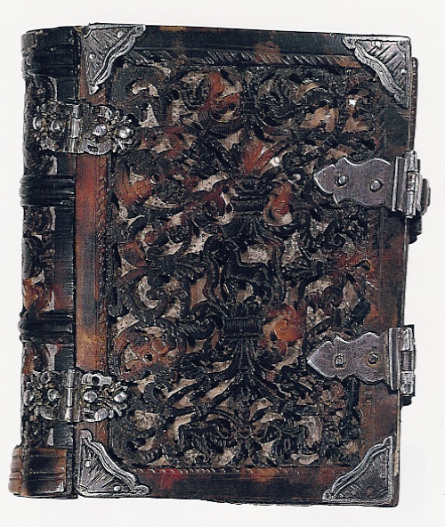
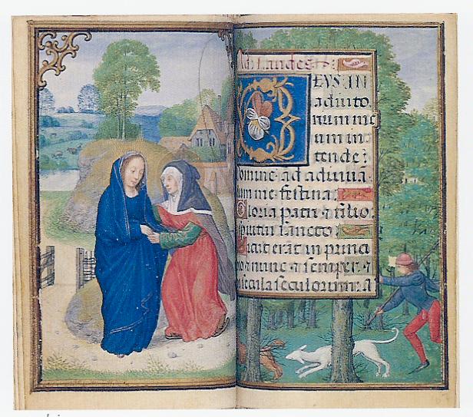
ILLUMINATED MANUSCRIPTS
During the middle ages, and prior to the invention of printing from type around 1456, books were written mostly by hand on vellum. Illuminated manuscripts are embellished with ornamented initials, borders, scrolls, miniatures – those original paintings used to decorate and describe the text –having nothing to do with the size of the book. and other designs usually in gold and /or colors. As we all know, fine medieval manuscripts are scarce, manuscripts with miniatures are scarcer still, and miniature manuscripts with fine miniatures are extremely rare.
The illumination you see here, is from a 16th century Book of Hours known as the Capricorn Hours, illuminated by the celebrated Flemish illuminator Simon Benning, which measures 97 mm by 63 mm, or just under 3 ” tall. It depicts the scene of the Visitation showing the Virgin and St. Elizabeth with a Flemish manor house in the background.
Notes:
During the middle ages, and prior to the invention of printing from type around 1456, books were written mostly by hand on vellum.Illuminated manuscripts are embellished with ornamented initials, borders, scrolls, miniatures – those original paintings used to decorate and describe the text –having nothing to do with the size of the book.and other designs usually in gold and /or colors. As we all know, fine medieval manuscripts are scarce, manuscripts with miniatures are scarcer still, and miniature manuscripts with fine miniatures are extremely rare.
The illumination you see here, is from a 16th century Book of Hours known as the, illuminated by the celebrated Flemish illuminator Simon Benning, which measures 97 mm by 63 mm, or just under 3 ½” tall. It is the scene of the Visitation showing the Virgin and St. Elizabeth with a Flemish manor house in the background.

Slide 6
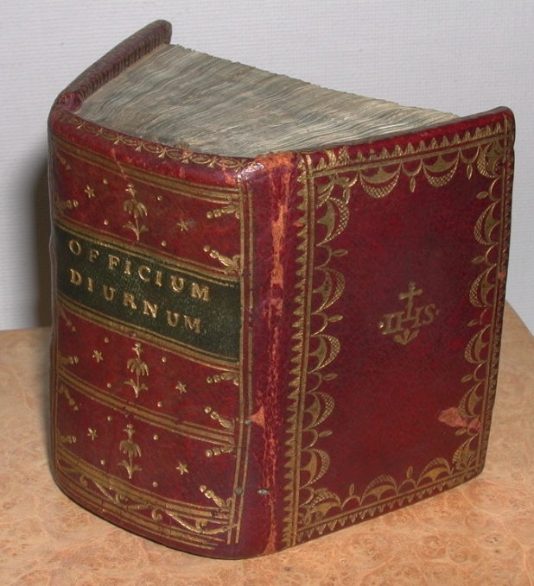
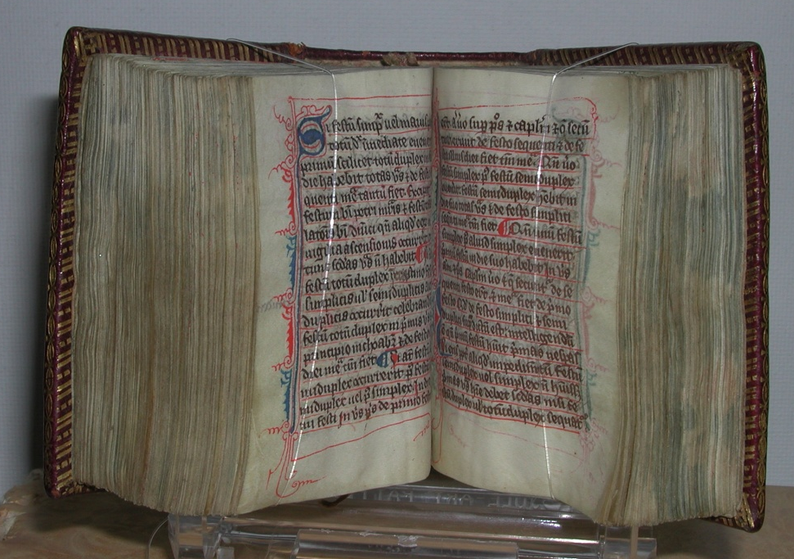
CALENDAR, PSALTER
& BOOK OF HOURS
The Church was the chief producer of manuscripts, and had the largest organization of scribes. For the most part, early miniature manuscripts were devotional and could be carried in the pocket of royalty, clergy or even the soldier going off to war.
This Officium Diurnum, a calendar, Psalter and book of hours for use by the Dominican Friars, was written in Latin and published in France in the late thirteenth century. It measures 2 5/8” tall x 1” wide.
Notes:
The Church was the chief producer of manuscripts, and had the largest organization of scribes. For the most part, early miniature manuscripts were devotional and could be carried in the pocket of royalty, clergy or even the soldier going off to war.
This calendar, psalter and book of hours for use by the Dominican Friars was written in Latin, in France in the late thirteenth century. It measures 2 5/8” tall High and 1 ¾” wide.

Slide 7
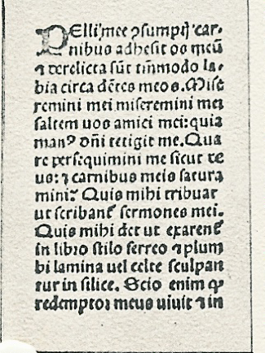
MINIATURE
INCUNABULA
Incunabula, is generally used to refer to books printed before 1501. It is the period from the printing of the Gutenberg Bible, circa 1450 to 1501, and is considered to be the infancy or cradle period of printing. More than 38,000 incunabula are known to have existed, mostly in folio or quarto sizes, and less than 50 were known in miniature.
The earliest miniature example is an Officium Beatae Mariae Virginis published in Venice by Nicholas Jenson in 1475 and measured only 2 ” high. The page to the left is from another miniature incunabulum – a Latin Horae – printed in Naples, in 1488.
Photograph courtesy of Julian Edison
Notes:
Incunabula, is generally used to refer to books printed before 1501. It is the period from the printing of the Gutenberg Bible, circa 1450 to 1501, and is considered to be the infancy or cradle period of printing. Over 38,000 incunabula are known to have existed, mostly in folio or quarto sizes, and less than 50 were known in miniature.
The earliest miniature example is an Officium Beatae Mariae Virginis published in Venice by Nicholas Jenson in 1475 and measured only 2 ¼” high. The page above is from another miniature incunabulum – a Latin Horae – printed in Naples in 1488.

Slide 8
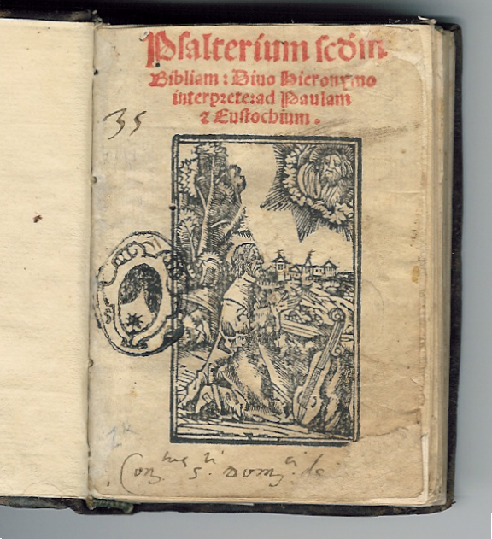
PSALTERIUM
BIBLIAM c. 1525
This early printed book is a Psalterium Bibliam, printed in Venice in 1525, in red and black ink, with a woodcut of King David on the title page.
Notes:
My earliest printed book is a Psalterium Bibliam, printed in Venice in 1525, in red and black ink, with a woodcut of King David on the title page.

Slide 9
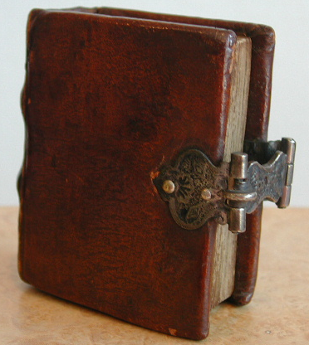
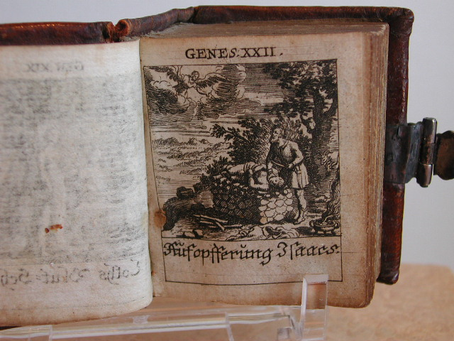
17TH CENTURY BOOKS
Most miniature books of the 17th century were religious in nature, and the thumb Bible became popular. This example is Dess Alten Testaments Mittler, printed in Switzerland in the late 17th century.
This thumb Bible is engraved throughout by the Kuslin sisters who were illustrators and painters in Switzerland, with depictions of scenes from the Old Testament. Here is Abraham offering his son to God. There are a total of 129 plates, plus the title page, and it is bound in contemporary calf with a silver metal clasp.
Notes:
Most miniature books of the 17th century were religious in nature, the thumb bible became popular. This example is Dess Alten Testaments Mittler, printed in Switzerland in the late 17th century

Slide 10
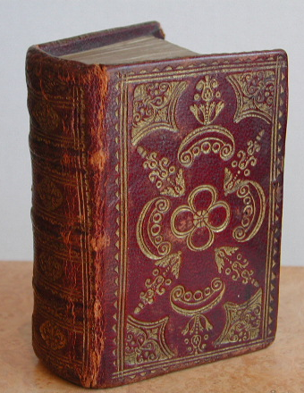
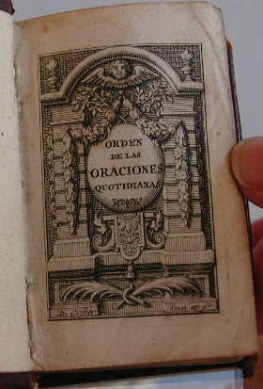
RELIGIOUS BOOKS
The Orden de las Oraciones Quotidianas – the order of daily prayers - was printed in the Hague in 1732 and measures 2 7/8” high by 1 7/8” wide. It is finely bound in a contemporary morocco gilt. What makes this miniature so special is that it is a fine Jewish prayer book in Spanish for Jews of Sephardic origin.
Notes:
The Orden de las Oraciones Quotidianas – the order of daily prayers - was printed in the Hague in 1732 and measures 2 7/8” high by 1 7/8” wide. It is finely bound in a contemporary morocco gilt, but what makes this so special is that it is a fine Jewish prayer book in Spanish for Jews of Sephardic origin.

Slide 11
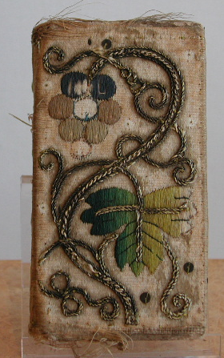
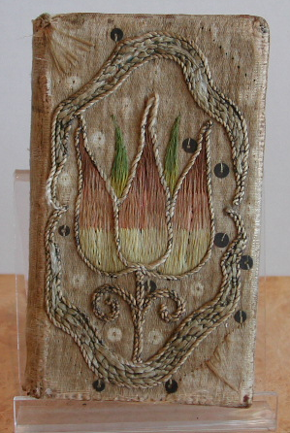
EMBROIDERED BINDINGS
The Company of Stationers in London published The Whole Book of Psalms in the 17th century, with bindings embroidered by the nuns Little Sidding, the only protestant monastic establishment in England.
Notes:
The Company of Stationers in London published The Whole Book of Psalms in the 17th century, with bindings embroidered by the nuns Little Sidding, the only protestant monastic establishment in England.

Slide 12
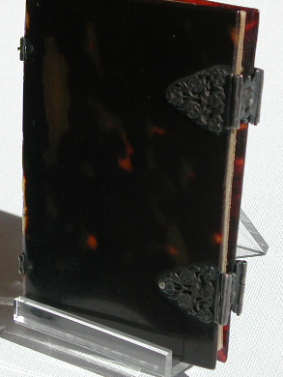
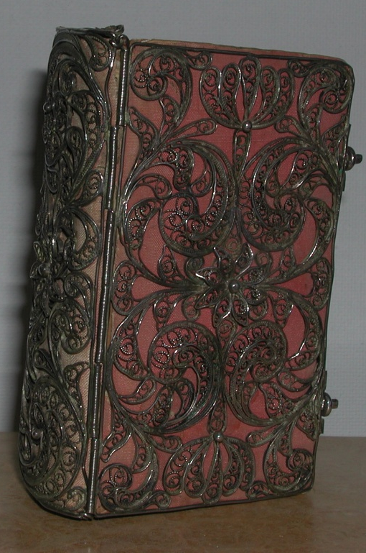
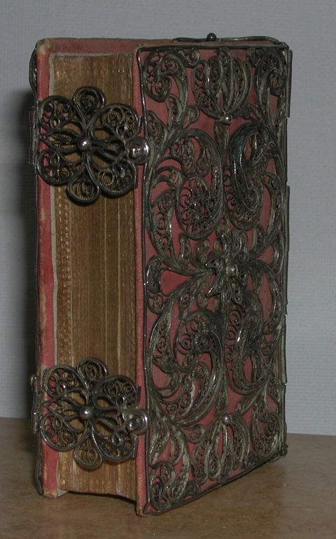
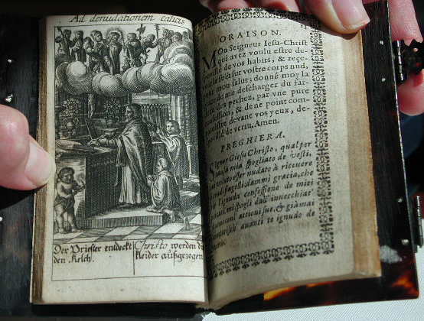
SPECIALTY BINDINGS
Another type of binding seen in the 17th century is Tortoise as seen on this beautifully engraved French prayer book printed in 1647.
The Officium of the Virgin Mary (below) was printed in 1685 in Venice has a beautiful 18th century ornate silver filigree binding over pink cloth.
Notes:
Another type of binding seen in the 17th century is Tortoise as seen on this French prayer book printed in 1647.

Slide 13
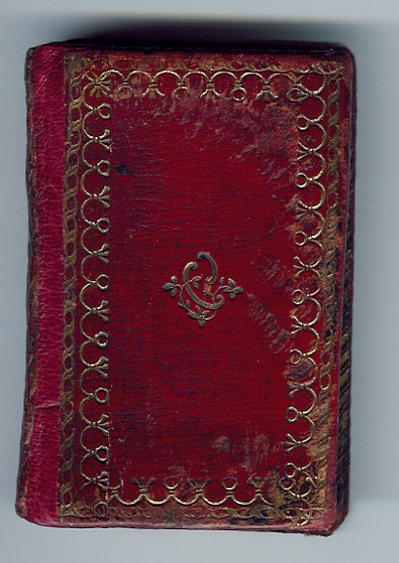
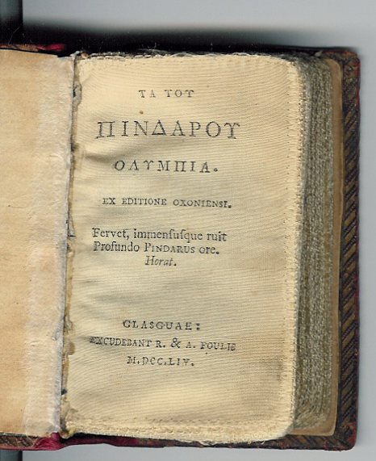
18TH CENTURY BOOKS
Religious books remained important in the 18th century, but the classics began to appear in miniature too. This tome of Pindar’s Olympia, was printed on silk in 1754.
Notes:
Religious books remained important in the 18th century, but the classic began to appear in miniature too. This tome of Pindars Olympia, was printed on silk in 1754.

Slide 14
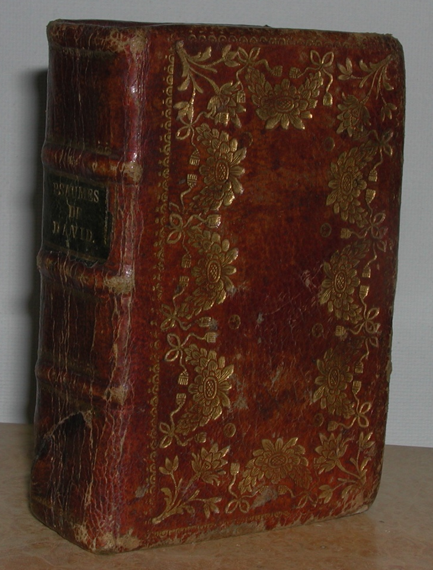
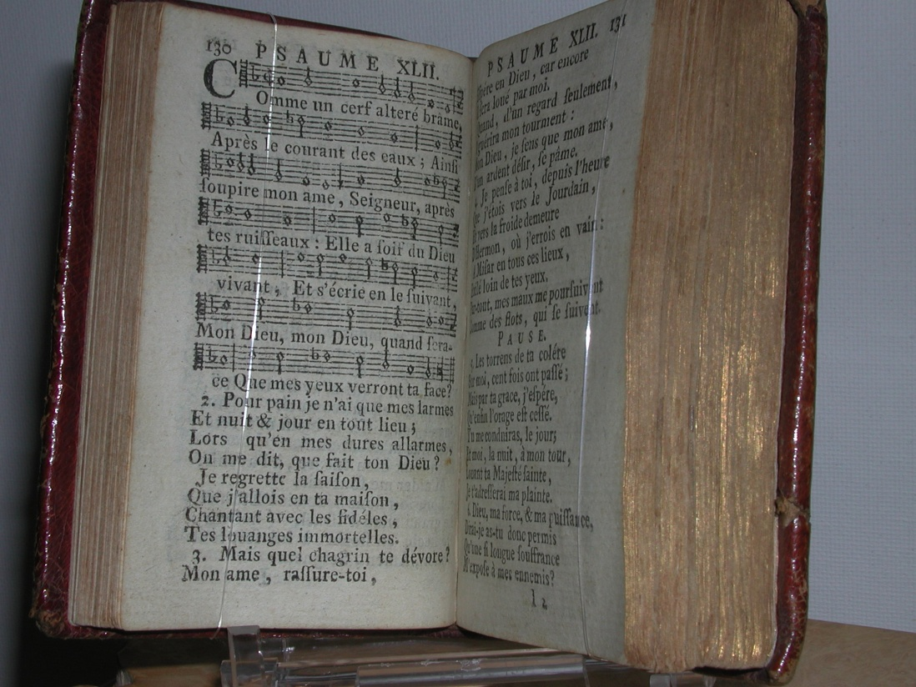
BOOKS OF PSALMS
In France, the art of the book reached a zenith in the 18th century and this was reflected in miniature books as well as you can see from gilded binding of Les Psalmes de David, printed in 1776.
Notes:
In France, the art of the book reached a zenith in the 18th century and this was reflected in miniature books as well as you can see from gilded binding of Les Psalmes de David, printed in 1776.

Slide 15
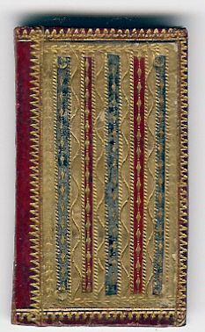
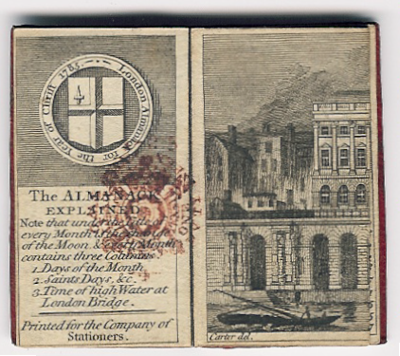
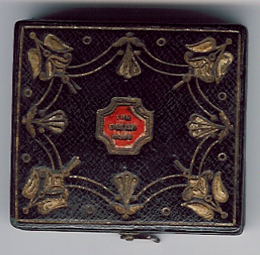
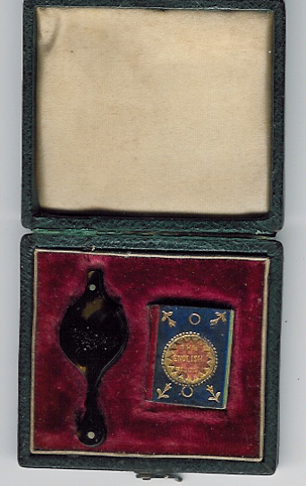
ENGLISH ALMANACS
In London, the Company of Stationers published the London Almanac each year from about 1680 to 1890 in different sizes and a variety of bindings. Almanacs were attractively engraved and included a calendar for each month, astronomical data and other bits of information. This handsomely Venetian mosaic binding (above) in multicolor morocco dates from 1781.
Some of the tinier almanacs, such as the Schloss Bijou series (right) were enclosed in morocco box cases, and came complete with their own tortoise shell magnifier.
Notes:
In London, the Company of Stationers published the London Almanac each year from about 1680 to 1890 in different sizes and a variety of bindings. Almanacs were attractively engraved and included a calendar for each month, astronomical data and other bits of information. This handsomely Venetian mosaic binding in multicolor morocco dates from 1781.

Slide 16
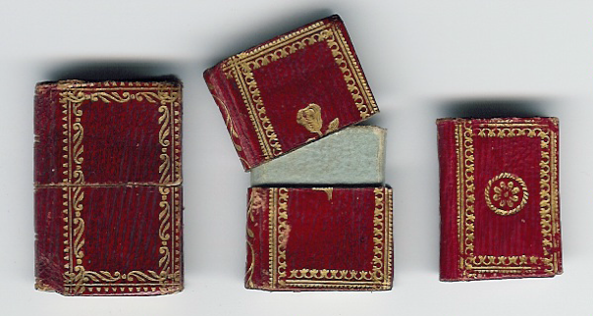
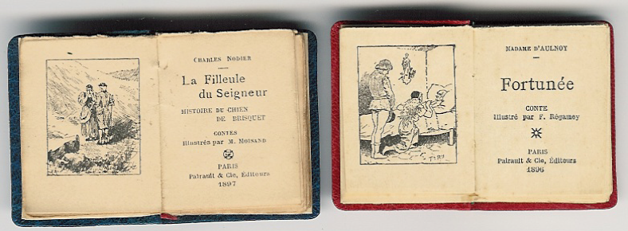
FRENCH ALMANACS
Small almanacs were the rage in France at this time. Almanacs most often came in gilt morocco bindings with engravings, but rare examples include a faux book slipcase.
Mini books became a popular way to interest children in reading.
Notes:
Small almanacs were the rage in France at this time. Almanacs most often came in gilt morocco bindings with engravings, but more rare examples include a faux book slipcase.
Mini books became a popular way to interest children in reading.

Slide 17
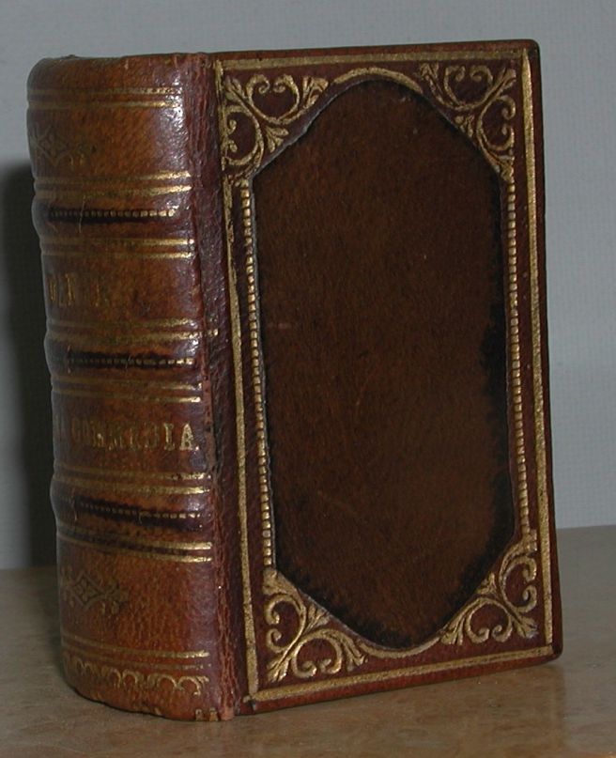
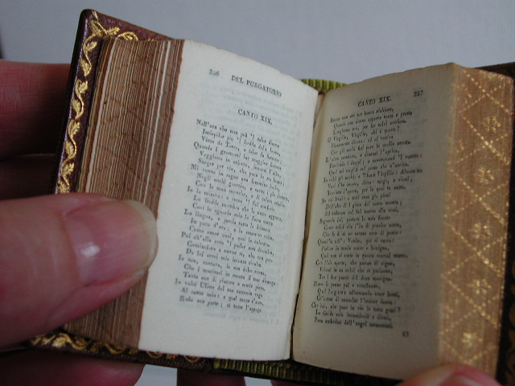
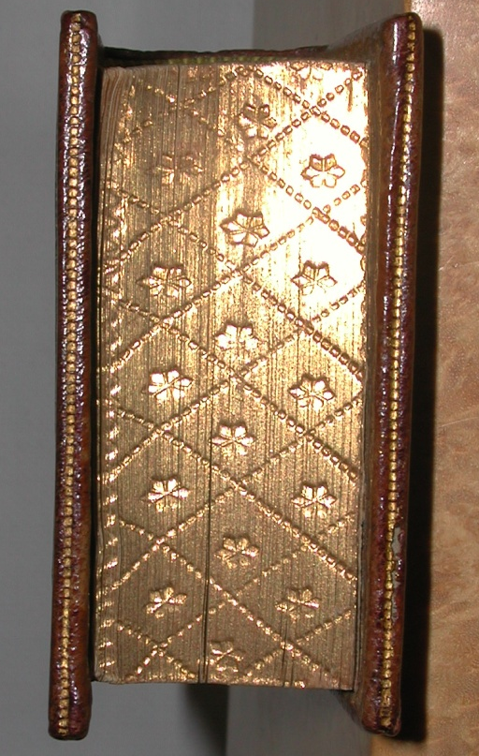
NINETEENTH CENTURY
During the nineteenth century, the popularity and subject matter of mini books expanded dramatically. The marriage of photography and lithography opened the way to simply copy larger volumes into a miniature format.
The race toward greater miniaturization took hold in the 19th century. Ulrico Hoepli of Milan used the famous 2 point “fly’s eye type” in Dante’s La Divina Commedia in 1878. This microscopic type face is said to have seriously injured the eyesight of both the compositor and the corrector. It took one month to print 30 pages and new types were necessary for every new form.
Notes:
During the nineteenth century, the popularity and subject matter of mini books expanded dramatically. The marriage of photography and lithography opened the way to simply copy larger volumes into a miniature format.
The race toward greater miniaturization took hold in the 19th century. The Ulrico Hoepli of Milan used the famous 2 point “fly’s eye type” in Dante’s La Divina Commedia in 1878. This microscopic type face is said to have seriously injured the eyesight of both the compositor and the corrector. It took one month to print 30 pages and new types were necessary for every new form.
Even Napoleon carried volumes of the Bibliotheque de Voyagers, a 40 volume set of French classics set in a wooden case on his journeys.

Slide 18
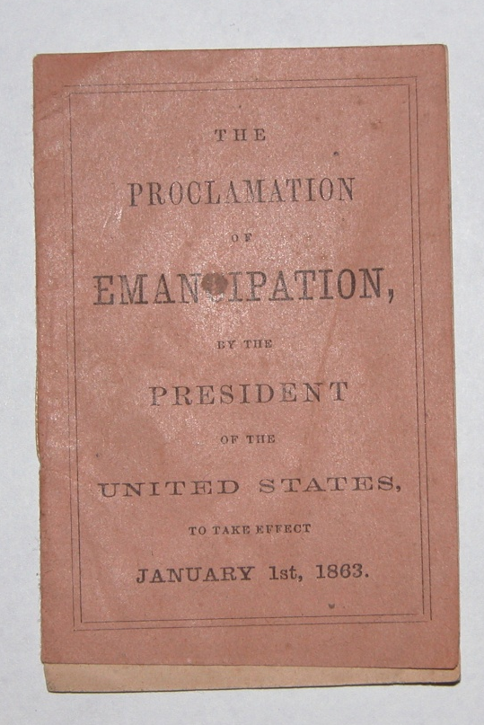
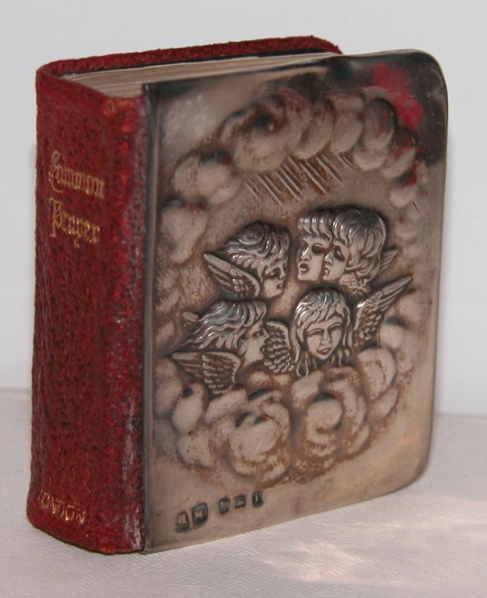
EMANCIPATION
PROCLAMATION
The Proclamation of Emancipation by the President of the United States to Take Effect January 1st, 1863 was widely distributed when first published. Copies of this historically important miniature book are rarely found today.
BOOK OF COMMOM PRAYER
At the turn of the 20th Century, books such as this Episcopalian Book of Common Prayer, as well as the books of poetry and almanacs were bound with beautifully embossed sterling silver front-covers.

Slide 19
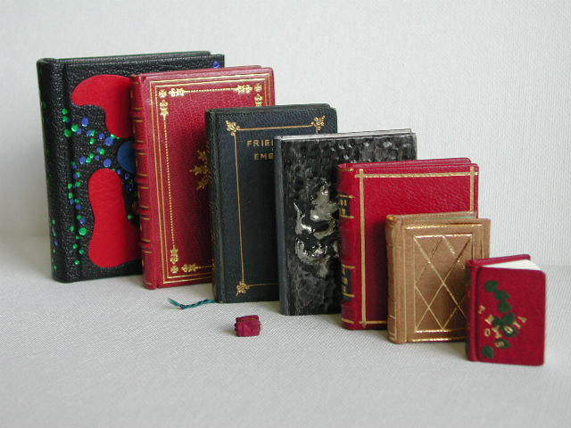
TWENTIETH CENTURY FORWARD
  In the 20th century, miniature books continue to proliferate and cover every subject matter.
Notes:
So that we are all on the same page – a miniature book is generally defined as being a tome approximately three inches tall by three inches wide or smaller. However books up to four inches are considered miniature, especially if they are older and meant to be a miniature.
Books in a miniature format possess a special appeal to many collectors. There is an intimacy and charm about them. Their small dimensions demand a gentle touch and careful handling. But in spite of their small size, minis satisfy very practical needs.

Slide 20
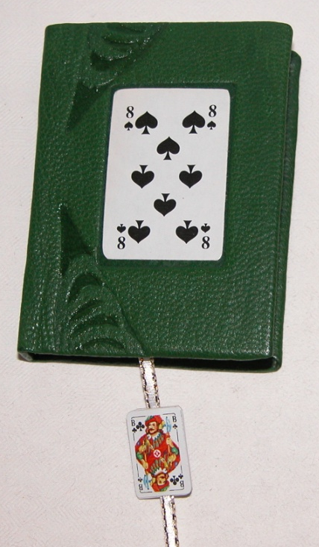
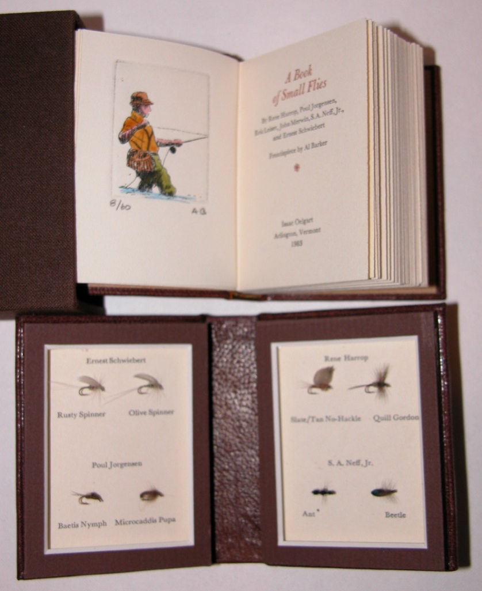
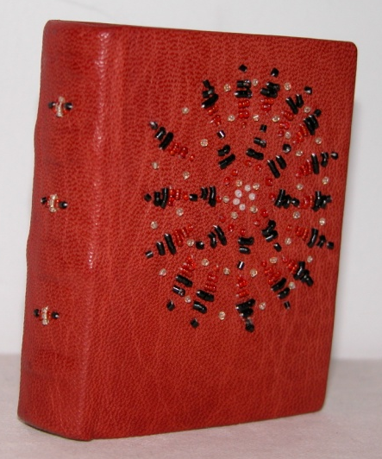
VARIETY OF SUBJECTS
The two volume cased set of A Book of Small Flies, published by Isaac Oelgart, includes a selection of eight miniature expertly hand-tied trout flies
Mini-Contract Bridge by Paul and Mary Devenyi provides the reader with a basic understanding of the game in a smartly bound tiny tome.
Shaman: Anthropo-morphic Figures in North American Rock Art, a one-of-a-kind binding by Gabrielle Fox has hand stitched beading, a compliment to the subject matter.

Slide 21

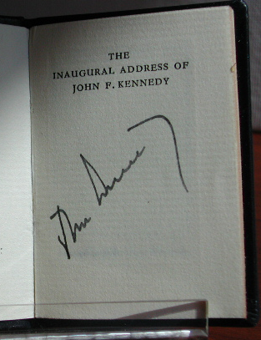
TRADITIONAL BINDINGS
One of the finest 20th century American publishers is considered to be Achille St. Onge. From 1935 to 1977 he published 46 books measuring around 2” tall by 1 7/8” wide in limited editions of about 300 copies each. But the key to collecting his work is to find the variant bindings. There can only be five truly complete collections because only five copies of the Coronation of Queen Elizabeth II were bound in the white leather scraps from the queen’s coronation bible.
This Inaugural Address of John Fitzgerald Kennedy was signed by the President. One of St Onge’s books went to the moon with Buzz Aldrin in 1969!

Slide 22
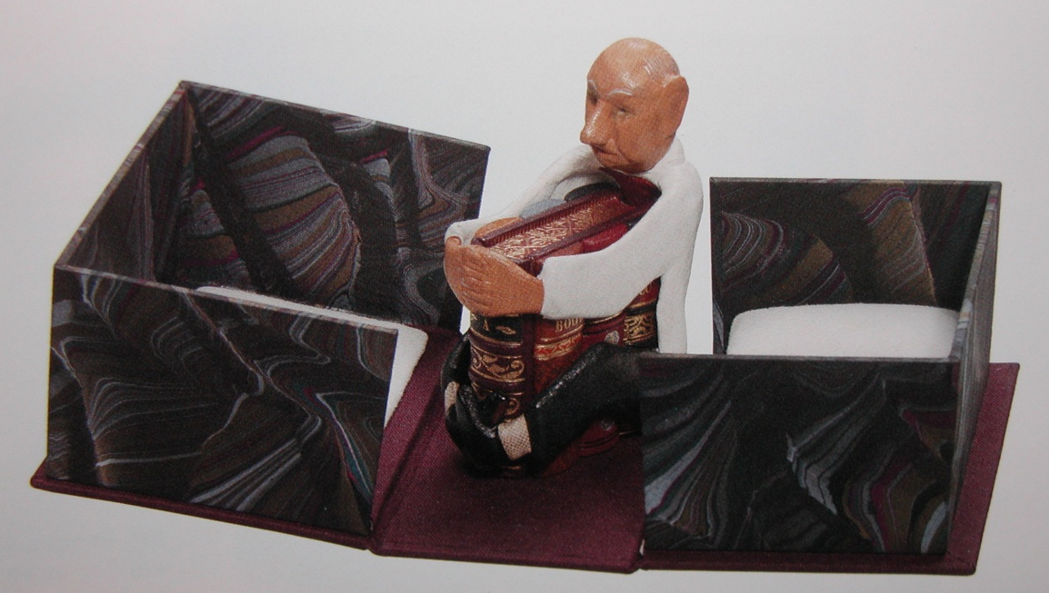
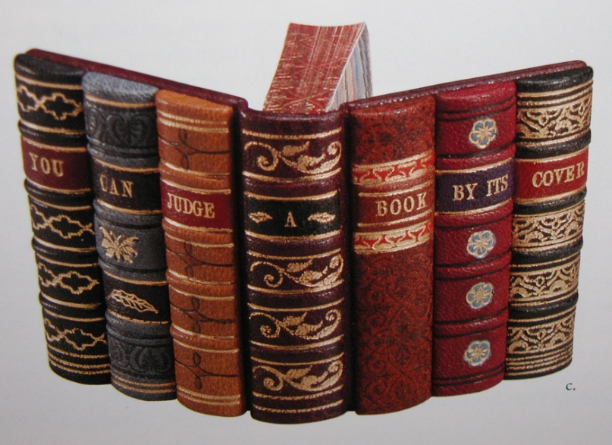
DESIGNER BINDINGS
Today, book artists create wonderful specialty bindings in limited editions. This is You Can Judge a Book by Its Cover. Publisher Mel Kavin created it by utilizing the talents of the top artist in each field of the book arts; the author, papermaker, typesetter, layout designer, illustrator, printer and binders. The uncut, printed sheets were sent to 32 other world-renown custom-design binders who were given instructions to bind the book anyway they wanted. As you can see from this example, the results were wonderful.
Showing front and back covers.
Clamshell box opened to reveal caricature of author holding book

Slide 23
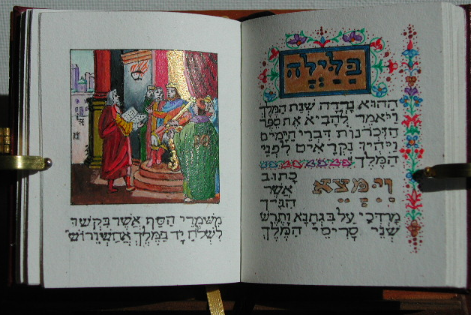
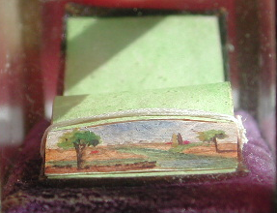
ILLUMINATED MANUSCRIPTS
Rest assured that the art of the illuminated manuscript has not been forgotten by today’s miniature book artists. This manuscript by Shannon Mitchell of the Book of Esther has 15 full-page illuminated miniatures.
FORE-EDGE
PAINTING
The medieval technique of fore-edge painting is still practiced today as seen in this beautifully detailed scene.

Slide 24
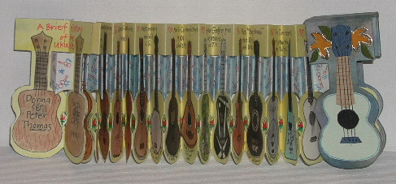
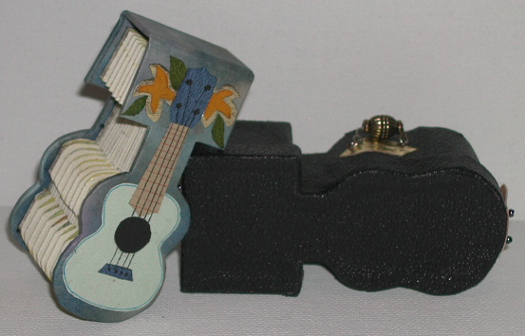
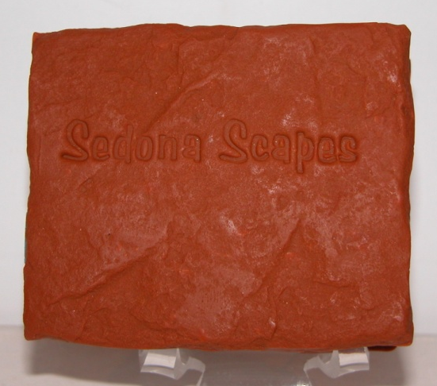
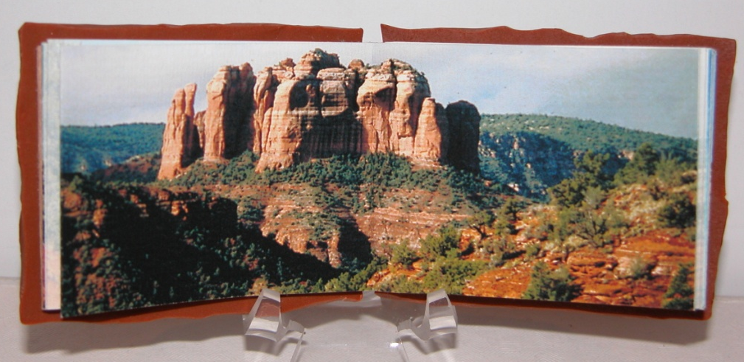
ARTIST’S
BOOKS
A Brief History of the Ukulele by Peter and Donna Thomas is a one-of-a-kind accordion style book on handmade paper, hand-color illustrated, and enclosed in it’s own carrying case.
Photographer Jill Timm published Sedona Scapes, a stunning collection of her photographs of the scenic Sedona desert.

Slide 25
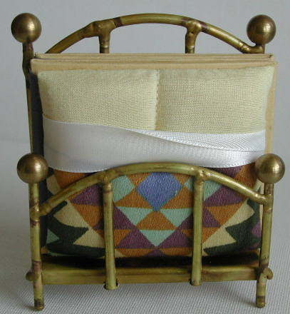
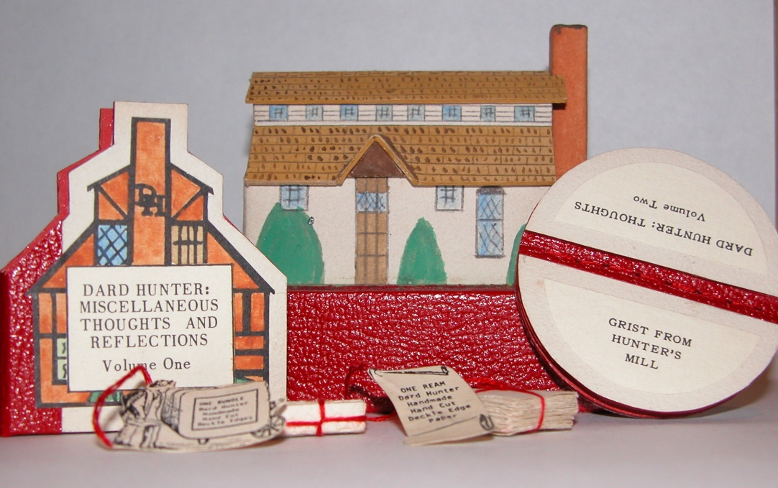
BOOK STRUCTURES
In this century, books have taken on unconventional structures as you can see from Robert Massman’s 2 volume set which is encased in a slipcover miniature of Dard Hunter’s mill.
Sleep Achiever published by Pat Baldwin of Pequeño Press, is a charming example of a dos-a-dos binding – that is twin volumes sharing a center board and opening in opposite directions - snuggled cozily in a brass bed holder.

Slide 26
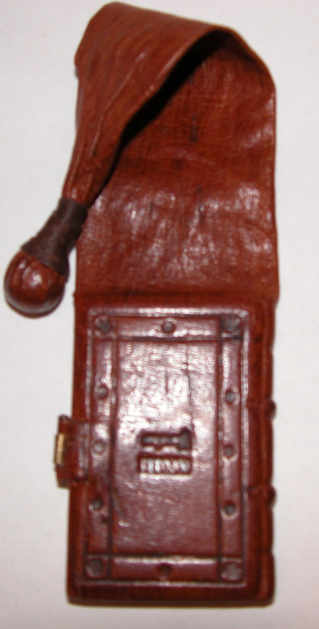

SPECIALTY BINDINGS
Miniature books have been bound in about every style and type of material – mother of pearl, ivory, silver, gold, embroidery, tortoise shell, snakeskin, shagreen, kangaroo skin and even money.
The Cigar Book, published by Pat Baldwin of Pequeño Press is bound in wood from a cigar box.
The 23rd Psalm published by Joy and John Tonkin has a girdle binding like those worn by monks centuries ago.

Slide 27





DOLL HOUSE BOOKS
These dollhouse-sized books are by the most prolific miniature book artist, Barbara Raheb, She has published more than 515 miniature books in editions of up to 300 volumes! Pictured here is a rare copy of Liber Culineria, measuring 1 3/8 by 7/16” (bottom left), it is beautifully printed and hand color illustrated.
One of Barbara’s specialties is pop-up books, Beatrix Potter’s Tom Kitten (right) has 4 hand-colored pop-ups in a tome that measures 1” x7/8”. Occasionally, Barbara does jeweled bindings, and illumination as in Charity, measuring 1” by 7/8” (bottom right).

Slide 28

MICRO-MINI-BIBLIOMANIA
In 1978, Glennifer press published Three Blind Mice. Measuring only 2.1 by 0.8 mm, it is the world’s smallest letterpress printed book. Even smaller is Old King Cole, a lithography work from 1985 that held the record for the smallest printed book in the world until 1996. What you are looking for are the tiny specs inside the circles. You would need a 15-power magnifier to read them!

Slide 29
The Guinness Book of World Records the smallest ever printed book
Anatoli Komehko of Omsk, Siberia Russia published Chameleon by Anton Chekhov. It measures .9mm x .9mm. The actual book is shown within the red triangle. Mini-book to the left of the frame is a readable version of tiny tome.

Slide 30
The miniature books in this presentation are from the private collections of:
Patricia Pistner
Mark Palkovic
Julian Edison
Lani Kowal
The Miniature Book Society acknowledges their generosity in allowing the public to enjoy these treasures.

